Slide 1

California State University , Los Angeles

Slide 2
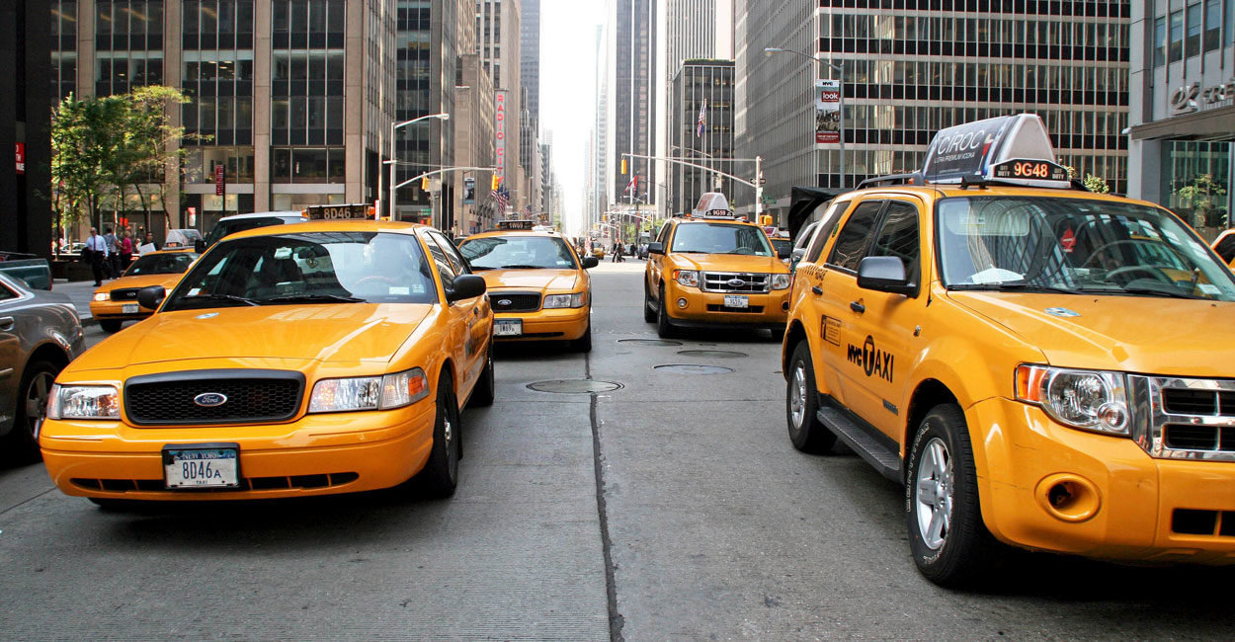
New York Yellow Taxi Analysis
Team Members:
Anjali Baldawa
Dhruvi Patel
Digesh Kansara

Slide 3
Abstract
This data set outlines using Apache Hive for an analysis of NYC Taxi Trips, presenting the analysis and visualization in Tableau Public for readers to interact with. To process with the analysis we have accessed multiple CSV files uploaded by NYC Taxi and then we will extract the data from these multiple CSV files and load it. There is one file named Tripdata_2013. File Trip data looks like this. Each file has about 14 million rows, and each row contains medallion, hack license, vendor id, rate code, store and forward flag, pickup date/time drop off date/time, passenger count, trip time in seconds, trip distance, and latitude/longitude coordinates for the pickup and drop off locations. This will include some analysis made with taxi data. There would be an analysis showing hourly trip_count, particular day, particular day.

Slide 4
Dataset Link:
The following is the below dataset link :
Data Set Size : 11 GB
https://chriswhong.com/open-data/foil_nyc_taxi/

Slide 5
System Specifications
Hadoop Cluster version : Hadoop 2.8.5-amzn-4
HDFS capacity : 147 GB
Storage : 678 GB
Hive Version : Hive 2.3.5-amzn-1
Cluster number of nodes : 3
Memory size :139949854720 (130.34 GB)
CPU Speed :2.28 GHZ
CPU :20 vCPU

Slide 6
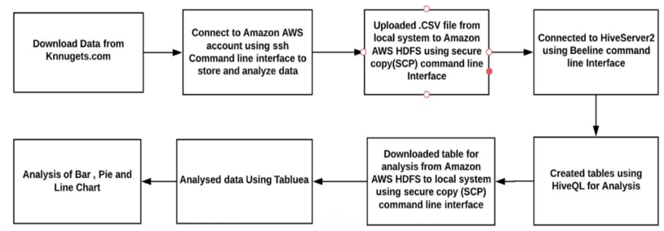
Flow Chart of Project

Slide 7

Analytic Problems and Visualization

Slide 8
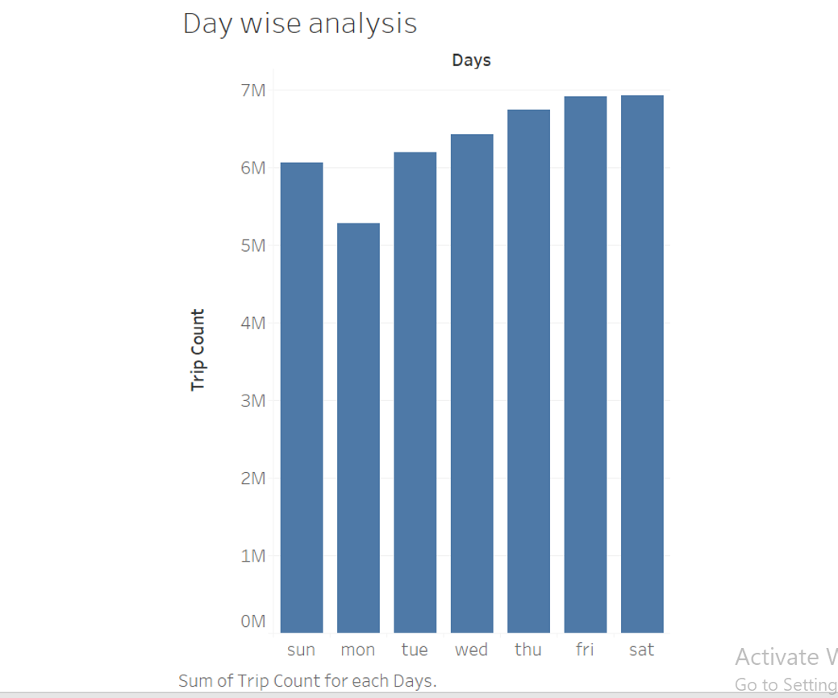
Part 1: Analysis for particular day of a week:
The column represents day of a week and row represents trip count.
We conclude that Monday is having the lowest number of booked trips, while Friday, Saturday have the highest number of trips in a week.
Select day, count (day) from analysis GROUP BY day ORDER BY day ASC;

Slide 9
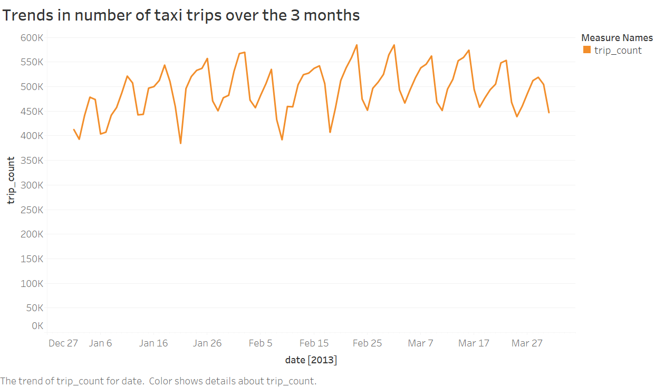
Part 2: Analysis of trip count during three months on a particular day
SELECT pickup_date, pickup_hour, COUNT (*) no_of_trips FROM analysis GROUP BY pickup_date, pickup_hour order by pickup_date ASC;

Slide 10
The above graph shows the analysis of trip count during the three months on a particular day. The row represents the trip count and the columns represents dates of three months.
The orange line in the graph represents the trip count on a particular day for the three months.
It can be depicted that trip count for Monday is low and for Saturday it’s the highest. Also on 21 January on the occasion of Marther Luther King day the trip count was low. We can assume that trips are low on public holidays.

Slide 11
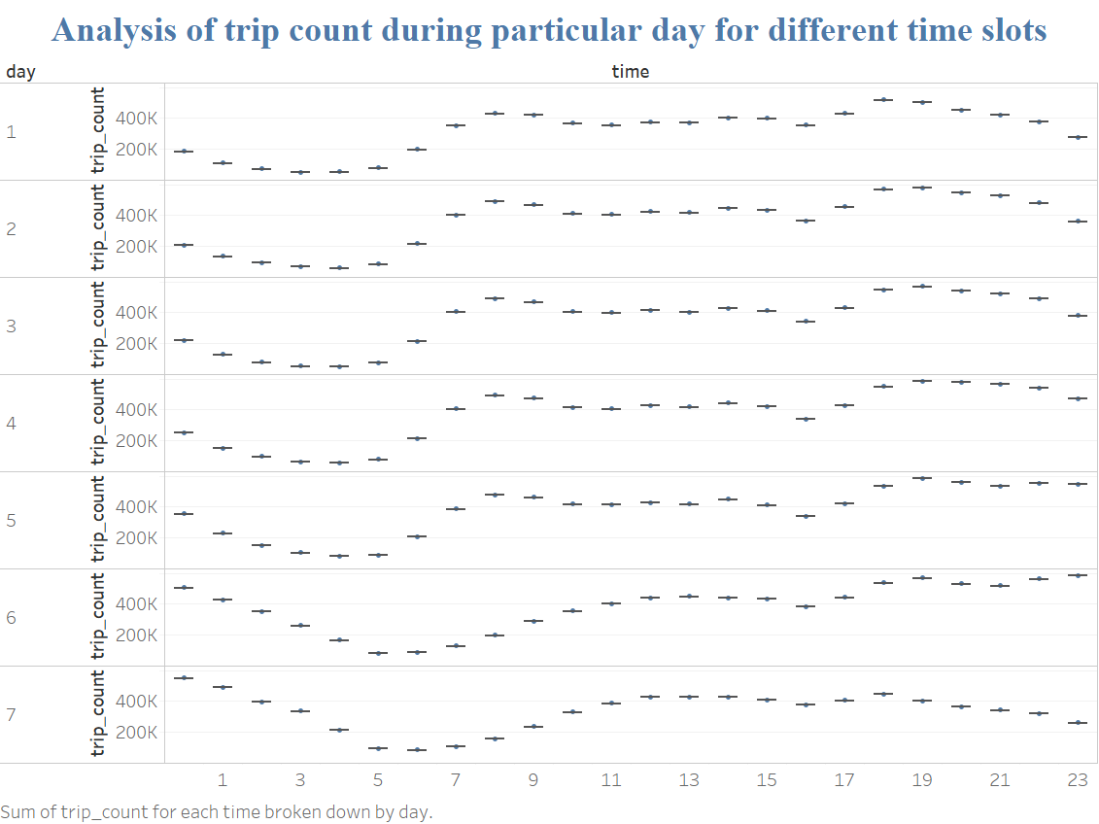
Part 3: Analysis of trip count during each day for different time slots
SELECT Day, hour, count (*) from taxi GROUP BY day, hour ORDER BY Day, hour Asc;

Slide 12
In the above graph the column represents time (24-hour format) and row represents trip count.
The following graph depicts the trip count during each day of the week for different time slot.
Through this graph we can say that peak hours are higher during the night for all the days whereas in the morning the trip count is not that high as compared to the night .
During Saturday’s and Sunday’s the trip count is the highest during 12:00AM – 2.00 AM compared to other days in the week.
From the graph we can conclude that in weekdays trip count gradually start increasing from 5 AM and reaches peak at 9AM and there is slight drop from 10 AM to 5PM( 17:00) and again it reaches peak point at 6PM (18:00) to 8 PM (20:00).

Slide 13
Part 4: Trip Count Analysis for short and long distance trips.

Slide 14
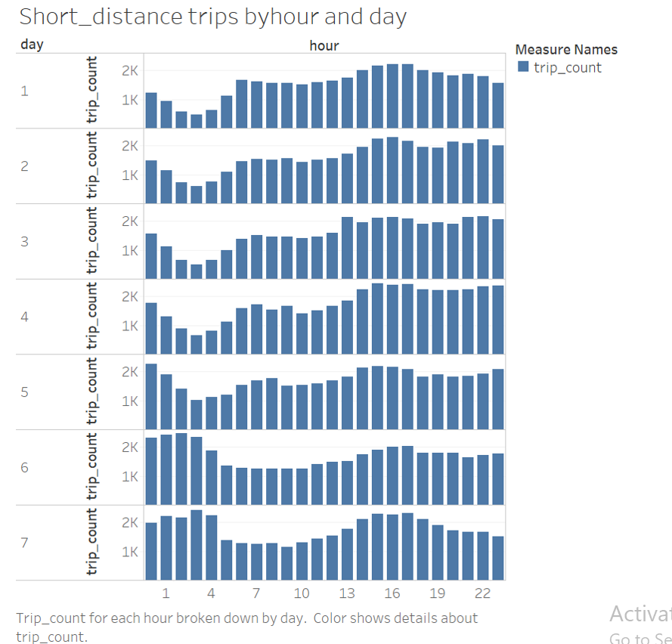
Analysis 4-a : Following Short_distance table used to count trips during particular hour of day.
SELECT day, hour,count(total_distance) from dropoff_day where total_distance<40 group by day, hour order by day ,hour ASC;

Slide 15
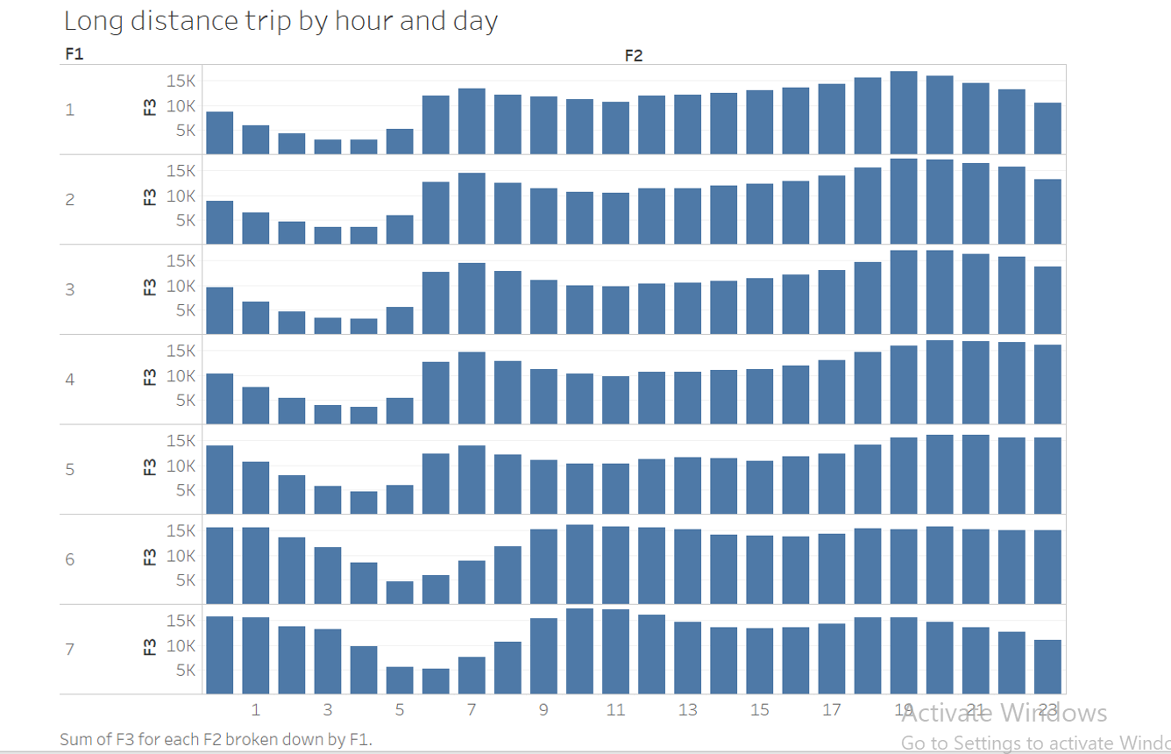
Analysis 4- b Following long_distance table used to count trips during particular hour of day.
SELECT day, hour, count(total_distance) from dropoff_day where total_distance>40 AND total_distance<150 group by day ,hour order by day ,hour ASC;

Slide 16
In the above graph row represents the trip count and column represents the hours (24 Hour Format).
By comparing both the short and long distance it has been observed that people prefer short distance trip in the morning whereas long distance trip is mostly preferred during evening hours.
During weekends long distance trip are higher than short distance trip in mornings.

Slide 17
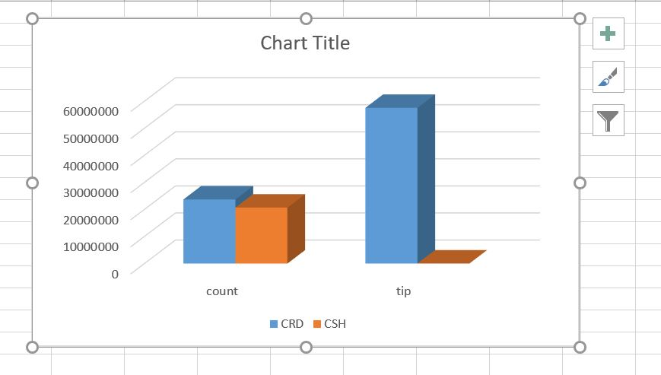
Part 5: Different Type of Payment Analysis
SELECT payment_type,count(payment_type),sum(tip_amount) from fair GROUP BY payment_type ORDER BY payment_type Asc;

Slide 18
This bar graph represents the payment method that is used by people while paying their fare amount. Most convenient way of paying the fares is either through cash or through card.
The blue color symbolizes the payment done through card and the orange color symbolizes the payment done through cash.
By analyzing the graph we can conclude that there is very little difference between the fares paid by cash and card whereas people prefer paying tip through card rather than cash.

Slide 19
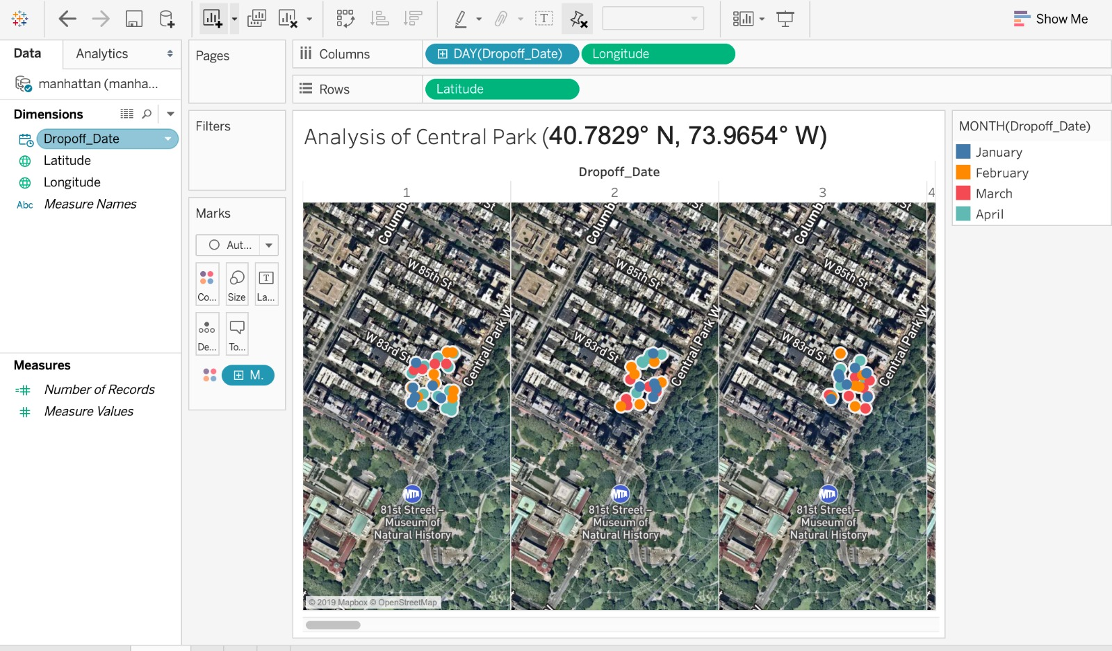
Analysis trend in Central Park using Geolocation :

Slide 20
We have chosen latitudes and longitudes as 40.7829 N , 73.9654 W and Day( Dropoff_date) to visualize the data. Each different color dot represents different months.
The above visualization shows the drop off taxi records for a particular area i.e Central Park for each day for 4 months. We did analysis and visualize every record through tableau maps.

Slide 21
Conclusion
According to this project we demonstrate how taxi trip count increases and decreases in a week and varies at particular time of a day. This analysis can be used for making business decisions which can be further used as a key element for marketing.
We had downloaded the dataset and uploaded to the HDFS , later the data was manipulated and analyzed in HDFS using Hadoop and visualization of the results was done in excel and tableau maps.

Slide 22
THANKYOU!!!

